Slide 1
LINQ & Entity Framework
David Turton
Conestoga College
Institute of Technology & Advanced Learning
dturton@conestogac.on.ca
Doon 2A605 x3610

Slide 2
LINQ: Introduction
LINQ: Language Integrated Query
A relational query language using C# syntax
LINQ-to-SQL
Generates SQL statements to access a relational database
LINQ-to-XML
Parses an XML file, delivering results similar to an SQL result table
LINQ-to-Objects
Applies SQL-like syntax to lists or collections in programs

Slide 3
Entity Framework: Introduction
Like a shell over LINQ
Enables dot-notation for properties & methods
Introduces lambda expressions
LINQ can use the context and models generated by EF
… so you can use either syntax
It can also include EF's dot-notation

Slide 4
LINQ uses ADO.NET
Active-X Data Objects
Abstracts the data storage mechanism:
SQL Server, MySQL, Sybase, Oracle, etc.
Defines database-specific classes:
System.Data.SqlClient.SQLDataAdapter
MySql.Data.MySqlClient.MySqlDataAdapter
System.Data.OleDb.OleDbDataAdapter
These are all used the same way:
Results returned as generic System.Data.DataTable objects
One DataTable object, regardless of the database used
So?
Application code doesn't care what the source database is
Same application code works with any relational database

Slide 5
Initial LinqTest View for examples
@model IEnumerable<Album>
@{
ViewBag.Title = "LinqTest";
}
<h2>@ViewBag.Title</h2>
<div asp-validation-summary="ModelOnly" class="text-danger"></div>
<table>
<tr>
<th>ID</th><th>Title</th><th>Artist</th><th>Genre</th><th>Price</th>
</tr>
@foreach (var item in Model)
{
<tr>
<td>@item.AlbumId </td>
<td>@item.Title </td>
<td>@item.Artist.Name </td>
<td>@item.Genre.Name </td>
<td>@item.Price</td>
</tr>
}
</table>

Slide 6
Selecting from database tables using LINQ
Context of (connection to) database … outside of methods, so all methods & actions can use it. Context was passed to constructor by Dependency Injection
private readonly MvcMusicStoreContext _context; // database context
public TestingController(MvcMusicStoreContext context) // constructor, accepting database context
{
_context = context;
}
// get all records from Album table, using LINQ
public IActionResult LINQtest()
{
try
{
var albums = from fred in _context.Album
select fred;
return View(albums);
}
catch (Exception ex)
{
ModelState.AddModelError("", "exception getting Albums: " + ex.GetBaseException().Message);
return View(new List<Album>());
}
}
fred will be mapped to each record from the Album table (as the table is known in the context)
Return each record, without changing its fields
If there's an error in the select, put the message into ModelState with an empty field-name & return to the view. The validation summary will display the message.
Entity Framework puts an exception or two around ones thrown by the database … return the innermost exception, the most specific one.

Slide 7
Selecting from database tables using Entity Framework
// get all records from Album table, using Entity Framework
public IActionResult EFtest()
{
try
{
var albums = _context.Album;
return View("LINQtest", albums);
}
catch (Exception ex)
{
while (ex.InnerException != null) ex = ex.InnerException;
ModelState.AddModelError("", "exception getting Albums: " + ex.Message);
return View(new List<Album>());
}
}
same context as LINQ example
Get the album table (known as Album in the context) … no filters: so all records, all fields
Force to same view as LinqTest action
The meatball way of getting to the innermost exception

Slide 8
Data from Related Tables
To show the artist & genre names (not ID's):
You need to ask for the related records to be included:
var albums = _context.Album
Becomes:
var albums = _context.Album.Include(a => a.Artist).Include(a => a.Genre);
Then the view can access properties on the artist & genre records
<td>@item.artist.name</td>
<td>@item.genre.name</td>

Slide 9
Accessing Related tables in LINQ
LINQ has a more SQL^{ish} way add related tables:
var albums = from anAlbum in db.albums
join anArtist in db.artists on anAlbum.artistId equals anArtist.artistId
join aGenre in db.genres on anAlbum.genreId equals aGenre.genreId
select new album
{
albumId = anAlbum.albumId,
title = anAlbum.title,
artistId = anAlbum.artistId,
genreId = anAlbum.genreId,
albumArtUrl = anAlbum.albumArtUrl,
artist = anArtist,
genre = aGenre
};

Slide 10
Better related-table access for LINQ
Or you could try this:
So… what's the difference between LINQ & Entity Framework again?
Actually, we're using both here
The lambda expression needs using Microsoft.EntityFrameworkCore;
The from "from fred in" and "select" parts of LINQ:
Allow us to do things to each record selected:
Aggregate data: sum/average/min/max fields, count records
Compute new fields, convert data. etc.
var albums = from fred in _context.Album.Include(a=>a.Artist).Include(a=>a.Genre)
select fred;

Slide 11
Filtering Records: WHERE clause
var albums = from record in db.albums
where (record.title.Contains("Hair"))
select record;
Notice that the where clause uses C# syntax
Including "( )" around the condition
Can use &&, ||, ==, !=, >=, .StartsWith(), and so on
String conditions are not case sensitive
This is the default setting when installing SQL
Entity Framework syntax:
var albums = db.albums.Where(a => a.artist.name == "Deep Purple"
&& a.title.Contains("disc"));
The compound condition uses C# syntax
… LINQ & EF are language-integrated

Slide 12
Lambda Expressions (anonymous functions) .Where(a => a.Title.Contains("disc"))
In math, it's a shortcut for something like this ...
(int i, int j) { return i * j; }
… or … (i, j) => { i * j; }
a => a.Title.Contains("disc")
Let "a" represent the current record => pick up its "Title" property
…now we can evaluate it using C# syntax
And can include compound expressions … and & or
.Include(a => a.Artist)
For each record, fetch its related Artist record

Slide 13
Where always returns an object - it is never null, though it may not contain records
var albums = _context.Album.Where(a => a.Title.Contains("hair"));
To see if Where found any records for the condition:
You could use:
if (albums.Count() > 0)
Better:
if (albums.Any())
.Count()
Reads all the records to count them
.Any()
Sees if the condition obtains one record, and goes no further

Slide 14
Selecting by Primary Key - or a unique field (candidate key)
var album = await _context.Album.SingleOrDefaultAsync(m => m.AlbumId == id);
If one record satisfies the condition
It'll be loaded to "album"
If no record satisfies the condition, "album" will be null …
if (album == null) TempData["message"] = $"no record for key {albumId}";
If more than one record satisfies the condition:
It jumps on a sharp pointy stick (throws an exception)

Slide 15
await … async? → Scalability
// get the record for the given primary key
public async Task<IActionResult> GetAlbum(Int32 albumId = 0)
{
Album album = await _context.Album.SingleOrDefaultAsync(m => m.AlbumId == albumId);
return View(album);
}
Both of these actions will work. The above asynchronous action will release IIS' process thread while it waits for the database server to respond … then it'll request a thread to fire up the view.
The bottom action will hold onto the thread until it finishes & will not scale well for many users.
// get the record for the given primary key
public IActionResult GetAlbum(Int32 albumId = 0)
{
Album album = _context.Album.SingleOrDefault(m => m.AlbumId == albumId);
return View(album);
}

Slide 16
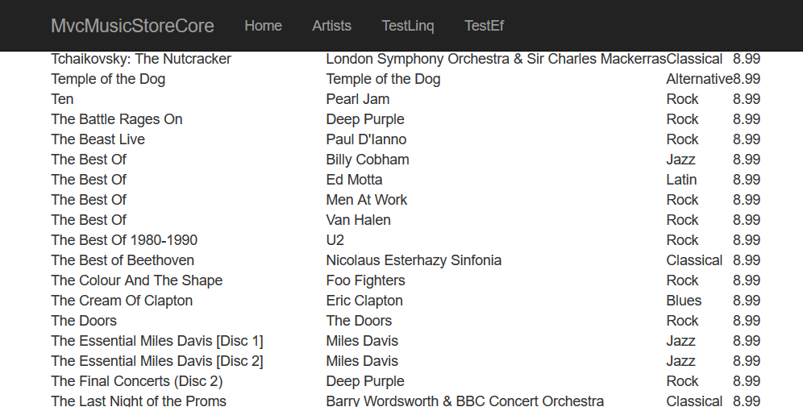
Ordering Output: OrderBy default: ascending sequence by primary key
I've omitted the Include statements to make these more readable
var albums = _context.Album.OrderBy(a=>a.Artist.Name).OrderBy(a=>a.Title);
All albums by artist, then by title within each artist
Well, that didn't work.
…last condition applied wins!

Slide 17
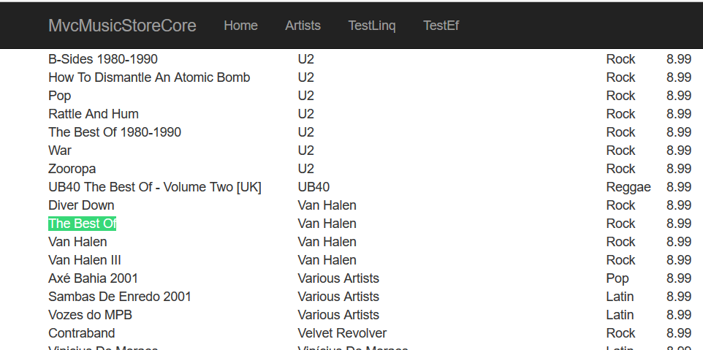
OrderBy … tries 2 & 3
Meatball …
Better
var albums = db.albums.OrderBy(a => a.artist.name + a.title);
var albums = db.albums.OrderBy(a => a.artist.name).ThenBy(a => a.title)
I've omitted the Include statements to make these more readable

Slide 18
OrderBy defaults to Ascending
So … how do you order one field ascending
And another descending? This works:
var albums = _context.Album.Include(a=>a.Artist).Include(a=>a.Genre)
.OrderByDescending(a => a.Artist.Name).ThenBy(a => a.Title);
Try LINQ instead of Entity Framework:
var albums = from fred in _context.Album.Include(a => a.Artist).Include(a => a.Genre)
orderby fred.Artist.Name descending, fred.Title ascending
select fred;
… this isn't C# syntax …
… more like SQL syntax …

Slide 19
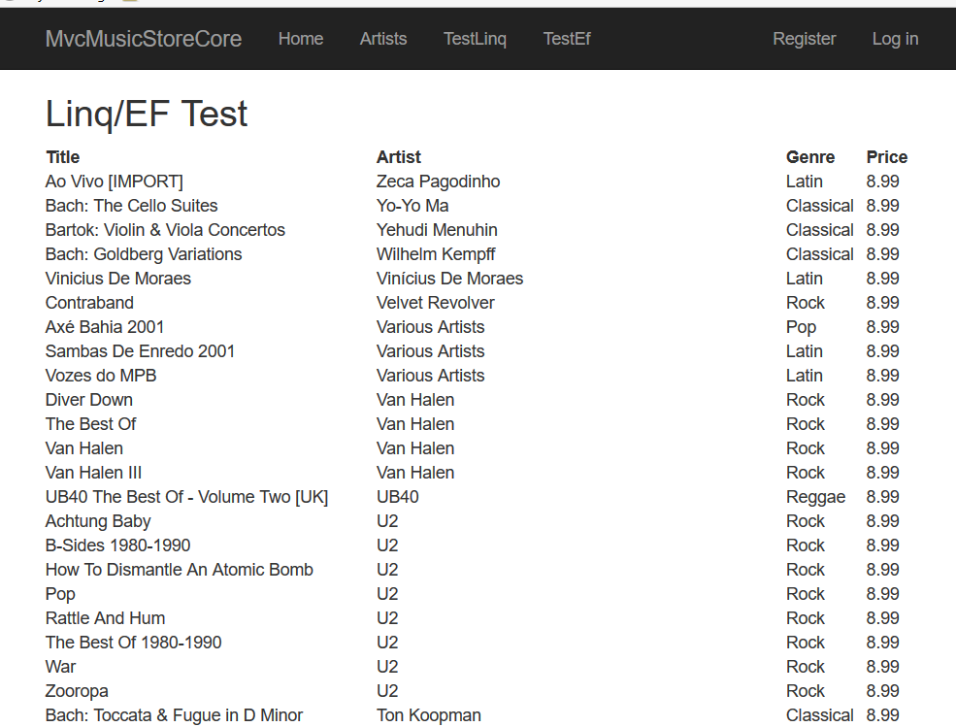
LINQ & EF are able to mix sort orders:
title ascending within artist descending

Slide 20
Skip() & Take() reduces the amount of data read & returned
Get first 10 records from a query:
var albums = _context.Album.Take(10);
Skip first 10 records, return next 10:
var albums = _context.Album.OrderBy(a => a.AlbumId).Skip(10).Take(10);
Skip() requires an OrderBy() clause before it
You can't say: .Take(10).Skip(10) …
Reduce result to 10 records … then skip 10?
LINQ example:
var albums = ( from record in _context.Album
orderby record.AlbumId
select record ).Skip(10).Take(10);
Question is: when's it do the "take" … after reading whole table?
Likely after reading first 20 … hence sort-before-skip
Important part → only 10 records are transferred
… web server is optimised to take such loads.

Slide 21
Computed & Extracted Fields … when you don't want all of the fields
Create a dynamic object in LINQ select clause:
if (surcharge < 0 || surcharge > 1)
throw new Exception("surcharge must be between 0 and 1 (100%)");
var albums = from record in _context.Album.Include(a=>a.Artist)
select new
{
Title = record.Title,
Artist = record.Artist.Name,
Price = record.Price * (1 + surcharge)
};
return View(albums);
new what?
Problem
The output is not a collection of album objects.
It's a collection of anonymous (dynamic) objects.
Razor doesn't know how to parse these from Model, ViewBag or ViewData

Slide 22
Create a View Model (class) & use this in LINQ instead of anonymous objects
public class PriceSurcharged
{
public string Title { get; set; }
public string Artist { get; set; }
public double Price { get; set; }
}
Did you remember to put this in "Models" namespace?
var albums = from record in _context.Album.Include(a => a.Artist)
select new PriceSurcharged
{
Title = record.Title,
Artist = record.Artist.Name,
Price = record.Price * (1 + surcharge)
};
return View(albums);
LINQ output now contains objects of View Model class
Can be passed & processed as ViewData's "Model"

Slide 23
View Model in use:
The viewmodel is actually in ~/Models/ViewModels, but I changed its namespace to say it's just in ~/Models
@model IEnumerable<MvcMusicStoreCore.Models.PriceSurcharged>
@{ ViewBag.Title = "LinqTest"; }
<h2>@VViewBag.Title</h2>
@Html.ValidationSummary()
<table>
<tr>
<th>title</th>
<th>artist</th>
<th>list price</th>
</tr>
@foreach (var item in Model)
{
<tr>
<td>@item.Title</td>
<td>@tem.Artist</td>
<td>@item.Price.ToString("c2")</td>
</tr>
}
</table>

Slide 24
LINQ to Entities does not recognize the method 'System.TimeSpan.Add… '
This came up when printing the bus schedule for a specific stop (x minutes along the route)
LINQ select section:
var times = from record in db.routeSchedules
where(record.busRouteCode == routeCode)
orderby record.busRouteCode
select new routeStopSchedule
{
routeCode = record.busRouteCode,
arriveTime = record.startTime.Add(TimeSpan.FromMinutes(offsetMinutes)),
isWeekDay = record.isWeekDay
};
Error thrown:
LINQ to Entities does not recognize the method 'System.TimeSpan.Add(System.TimeSpan)' method, and this method cannot be translated into a store expression.
Solution:
arriveTime = (TimeSpan)
System.Data.Objects.EntityFunctions.AddMinutes(record.startTime, offsetMinutes),
Or:
Create the collection with just the start time
Do a foreach loop afterwards on the resulting collection
And add the stop's offsetMinutes to each startTime
… and you don't need the view model
Not eveything in C# is implemented in LINQ

Slide 25
Group By combining data on the fly: sum/average/count
var artistCount = from fred in _context.Album
group fred by new
{
fred.ArtistId,
fred.Artist.Name
} into condensedFred
select new LinqTestArtistCount
{
artist = condensedFred.Key.Name,
count = condensedFred.Count(),
totalPrice = condensedFred.Sum(a => a.Price),
averagePrice = condensedFred.Average(a => a.Price)
};
return View(artistCount.OrderByDescending(a => a.count));
Summarise similar fred objects into this grouped object
From which you can build a result collection

Slide 26
ViewModel used in group-by
Physically, this one's in ~/Models/ViewModels
M. Consistent, c'est moi.
namespace MvcMusicStoreCore.Models
{
public class LinqTestArtistCount
{
public string artist { get; set; }
public Int32 count { get; set; }
public double totalPrice { get; set; }
public double averagePrice { get; set; }
}
}

Slide 27
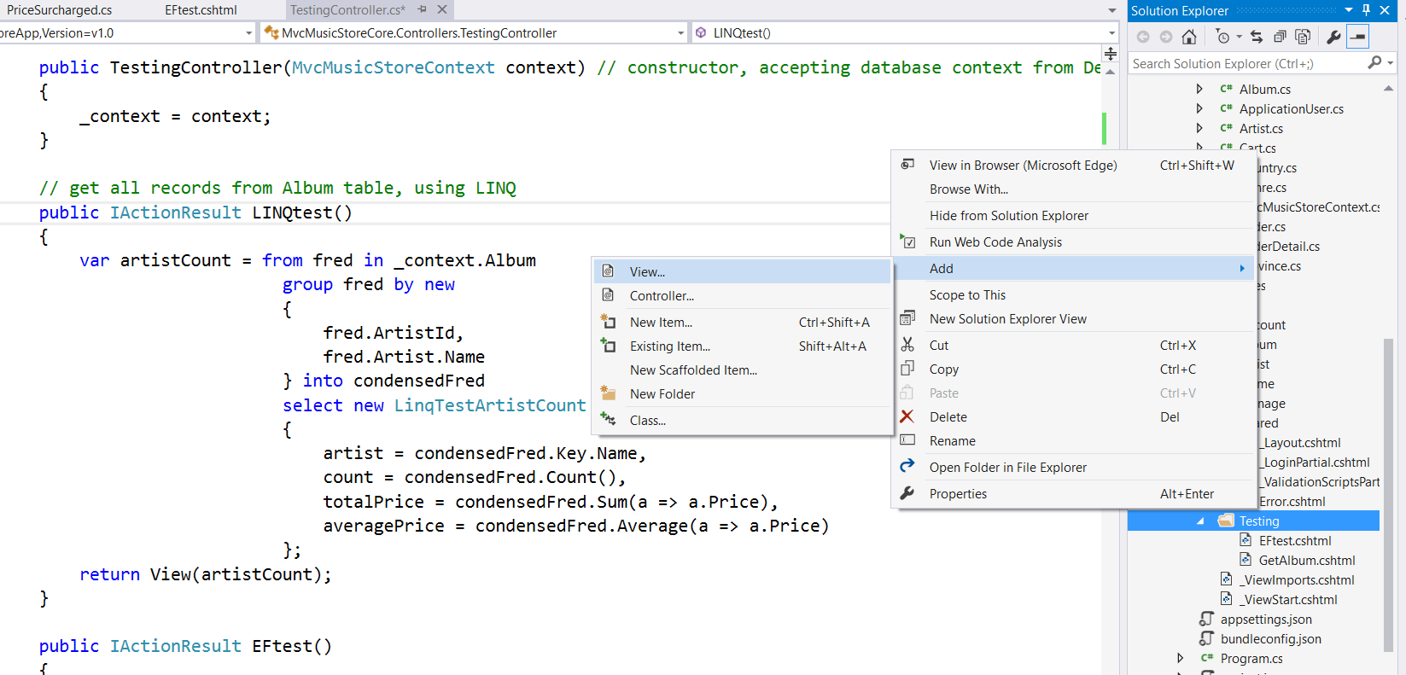
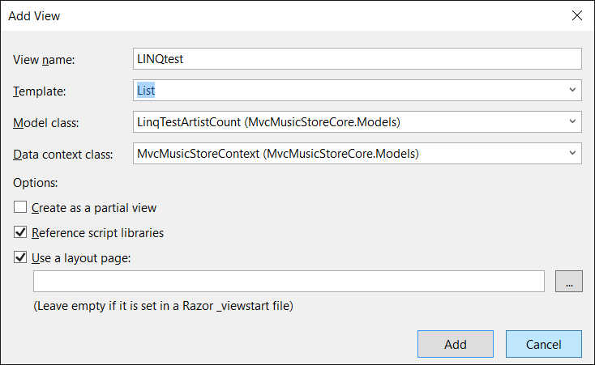
You can generate a View from a ViewModel

Slide 28
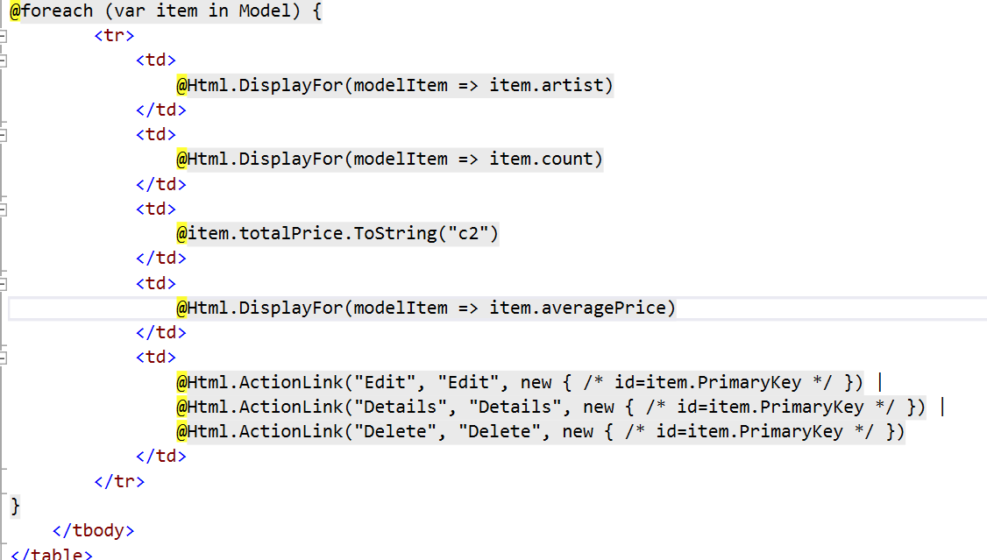
Resulting View (partial)
You don't have to use the HTML Helpers, especially if you want to do formatting
This gives several decimal places … lambda expressions don't support ToString formatting

Slide 29
var artistCount = from fred in _context.Albums.Include(a=>a.Artist)
group fred by new
{
fred.ArtistId,
fred.Artist.name
} into condensedFred
Get all the records from the albums table
Group the records by artist ID & name
Create a intermediate object (called condensedFred)
That will be composed of key fields
The fields specified in the group-by clause
And other fields from records of same artist:
Available only in aggregate: sum, average, min, max, etc.
Cannot be addressed individually anymore
No way to identify which one you want

Slide 30
…} into condensedFred
select new LinqTestArtistCount
{
artist = condensedFred.Key.Name,
count = condensedFred.Count(),
totalPrice = condensedFred.Sum(a => a.Price),
averagePrice = condensedFred.Average(a => a.Price)
};
Out of the collection of grouped records:
Create a new object of the LinqTestArtistCount class
Can address the key (group-by) fields individually
Everything else is referenced by using a function:
Sum, average, min, max, concat
Create a list of all values for a field
Check if any (or all) values of a field satisfy a condition
Count() source records used in each grouped record

Slide 31
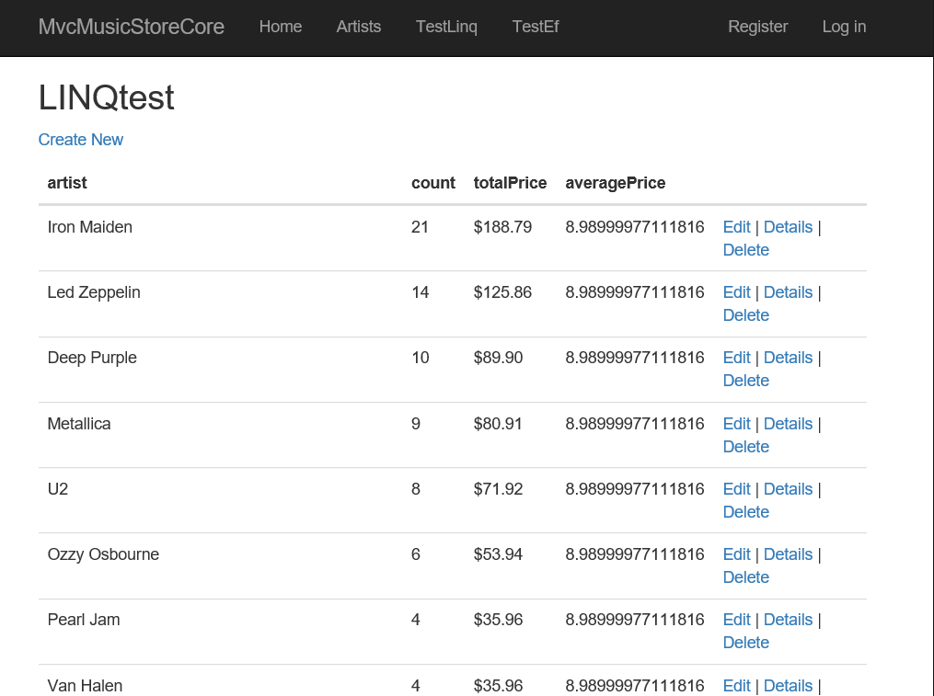
…and it works!

Slide 32
Exception Handling
Handling exceptions thrown by SQL Server

Slide 33
Adding a new record don't just jump on a sharp pointy stick
Basically, modify the generated CRUD code:
Create an object of the class
Declare that the object is to be inserted (add it to queue)
Submit/commit changes to database
Set up a one-time message to user about success (TempData)
Return to view or redirect to another action
Then wrap it in a Try/Catch:
Try section:
Return to the Index action
Catch section:
Put the innermost exception message into ModelState or TempData
And let it continue to the sad path
The view will show the exception to the user
… also retains & returns user’s data by not blowing up

Slide 34
Watch for encapsulated Exceptions
If SQL throws an exception
This is passed up a couple of levels in LINQ/EF
Each level encapsulates the prior level's exception
As the InnerException inside a new exception
If the InnerException is not null
You're not at the innermost exception, the one from SQL
Drill down to the innermost exception for user:
ModelState.AddModelError("", ex.GetBaseException().Message);
//or//
while (ex.InnerException != null) ex = ex.InnerException;
ModelState.AddModelError("", ex.Message);

Slide 35
Adding a new record
public async Task<IActionResult> Create([Bind("…")] Album album)
{
try
{
if (ModelState.IsValid)
{
_context.Add(album);
await _context.SaveChangesAsync();
// if you got here, the save worked ... tell the user so.
TempData["message"] = $"record added: {album.Title}";
return RedirectToAction("Index");
}
}
catch (Exception ex)
{
ModelState.AddModelError("", ex.GetBaseException().Message);
}
ViewData["ArtistId"] = new SelectList(_context.Artist, "ArtistId", "Name", album.ArtistId);
ViewData["GenreId"] = new SelectList(_context.Genre, "GenreId", "GenreId", album.GenreId);
return View(album);
}
Happy Path
Sad Path for
model errors
and
I/O exceptions
eek!
These are nice, but not necessary … like textboxes, model values will be pushed into <select>

Slide 36
Updating a record
Again, polish up the generated EF code:
Create or obtain an object of the class
Modify its fields
Declare the object as modified & add to queue
Submit/commit changes to database
Set up a one-time message to user about success
Return to view or redirect to another action
Already has a try-catch … add a less-specific exception
Catch & handle database exceptions as model errors
Again: don't lose the user's input …
They'll not thank you for that:
Method="POST" means they can't use "back" on browser

Slide 37
Updating a record
[HttpPost]
[ValidateAntiForgeryToken]
public async Task<IActionResult> Edit(int id,[Bind("AlbumId,AlbumArtUrl,ArtistId,GenreId,Price,Title")] Album album)
{
if (id != album.AlbumId) return NotFound();
if (ModelState.IsValid)
{
try
{
_context.Update(album);
await _context.SaveChangesAsync();
TempData["message"] = $"record updated: {album.Title}";
return RedirectToAction("Index");
}
catch (DbUpdateConcurrencyException ex)
{
if (!AlbumExists(album.AlbumId))
{
ModelState.AddModelError("", $"albumId is not on file {album.AlbumId}" );
}
else
{
ModelState.AddModelError("", "concurrency exception: " + ex.GetBaseException().Message);
}
}
catch (Exception ex)
{
ModelState.AddModelError("", "update error: ",ex.GetBaseException().Message);
}
}
ViewData["ArtistId"] = new SelectList(_context.Artist, "ArtistId", "Name", album.ArtistId);
ViewData["GenreId"] = new SelectList(_context.Genre, "GenreId", "GenreId", album.GenreId);
return View(album);
}
Don't just re-throw the exception …
More-specific exceptions must be caught before more-general ones
"Exception" encompasses all other exceptions … must be caught last

Slide 38
Deleting records again … buffed to a professional level
Original & response Delete actions take same parameter type
They can't be named the same, so this one is renamed.
"ActionName" links this as the response for post-back "Delete"
[HttpPost, ActionName("Delete")]
public ActionResult DeleteConfirmed(int id)
{
try
{
album album = db.albums.Find(id);
db.albums.Remove(album);
db.SaveChanges();
TempData["message"] = $"album title '{album.title}' deleted from database");
return RedirectToAction("Index");
}
catch (Exception ex)
{
TempData[”message”] = "error on delete: " + ex.GetBaseException().Message;
}
return RedirectToAction("Delete", new { ID = id });
}
Put the exception in TempData because the generated Delete view doesn't show ModelState errors.

Slide 39
Sad Path → setup shortcut
Generated "Get" actions
Usually have some setup … SelectList and such
Generated post-back actions
Have lost the original setup
… so need the same setup performed in the sad path
If you write your own actions
Or modify the generated "Get" setup
… copy its setup to post-back's sad path
→ or try this in the post-back Create's sad path
Create();
return View(Album);
This re-does the original ViewData/ViewBag setup … which remains "live" when the view is called with post-back's model and ModelState errors
Question … when the model has data, will the drop-downs be set to the old value?

